Slide 1
pocketPenny
discover, reflect, save

Slide 2
Inspiration for pocketPenny
Financial literacy is a fundamental skill, however, certain demographics are less likely to be taught budgeting skills and lack the ability to grow financially.
We built pocketPenny based on Kakeibo, a Japanese budgeting method that tracks all expenses and focuses on awareness rather than numbers.
pocketPenny takes it a step further by striving to teach you the fundamentals of money management: how to get it, how to spend it, and how to keep it.

Slide 3
You may be thinking…

Slide 4
Why this app over all the others?
There are hundreds if not thousands of applications geared towards developing a budget and tracking your expenses.
pocketPenny doesn’t just care if you save money. We care that you’re learning how to use your money and that those skills stick with you as you grow financially.
While it may start with budget planning, financial stability and freedom is achieved by long-term mindsets and practices, not monthly goals.

Slide 5
Areas That You Grow With pocketPenny
Budget Tracking
Financial Literacy
Responsible spending
Saving

Slide 6
How It Works

Slide 7
Create an account
Connect your banking profiles
Create your budget plans
Since pocketPenny works to give you detailed plans and budgets for long periods of time, this information will be attached to an account backed by two-factor authentication and backup codes
Once you create an account, you link your banking profiles using a secure system, giving pocketPenny access to your transactions. This allows it to track your expenses and predict your savings
Aimed with all the necessary data, pocketPenny then designs a budget plan for you, maximizing savings but allowing for personal indulgences

Slide 8

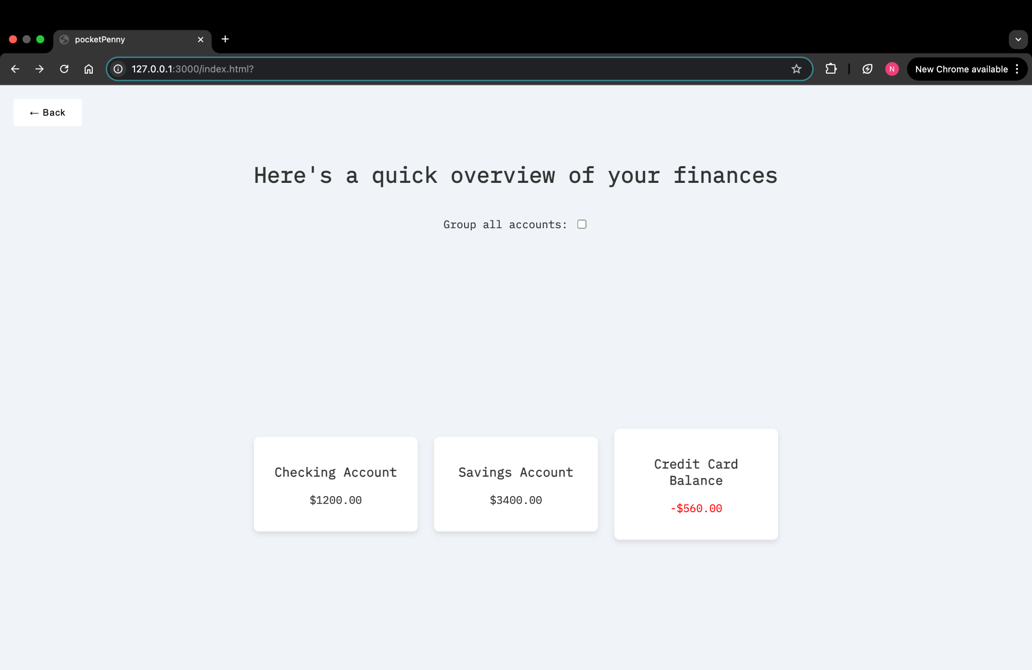
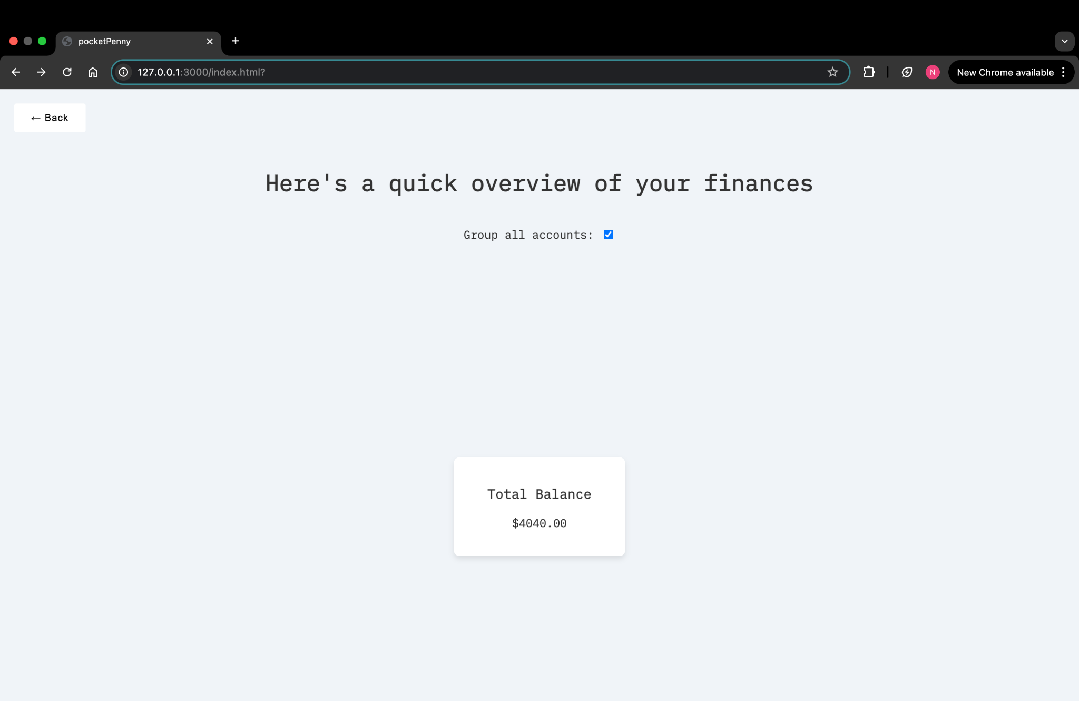
Merged or Separate?
Do you want a detailed plan for each banking profile you connect to pocketPenny?
Do you want a general plan on how to use all of your accounts to reach your saving and spending goals?
Either way, pocketPenny has you covered

Slide 9
penny the pincher
1
2
3
4
an opportunity for a purchase
plan with penny
penny’s recommendation
decision
You really want to buy something but don’t want to break your budget. penny is here for you, ready to prove her name is well-earned
Go over your current spending trend, saving goals, and chat with penny
Based on your responses, penny will tell you whether or not your purchase would align with your goals
After making your decision, penny will give you a projected look at your balances and budget. If it’s not to your liking, you can re-evaluate your decision with penny

Slide 10
future plans
have our responses be more readable and pleasing to the eye
allow users to connect with plaid banking
allow penny the pincher to analyze user bank accounts accurately
how we can grow pocketPenny

Slide 11


meet the team
Daniella Ghonda
CS Undergrad
Nardi Hailemariam
CS undergrad

